Slide 1


Keeping Environment Clean

Slide 2
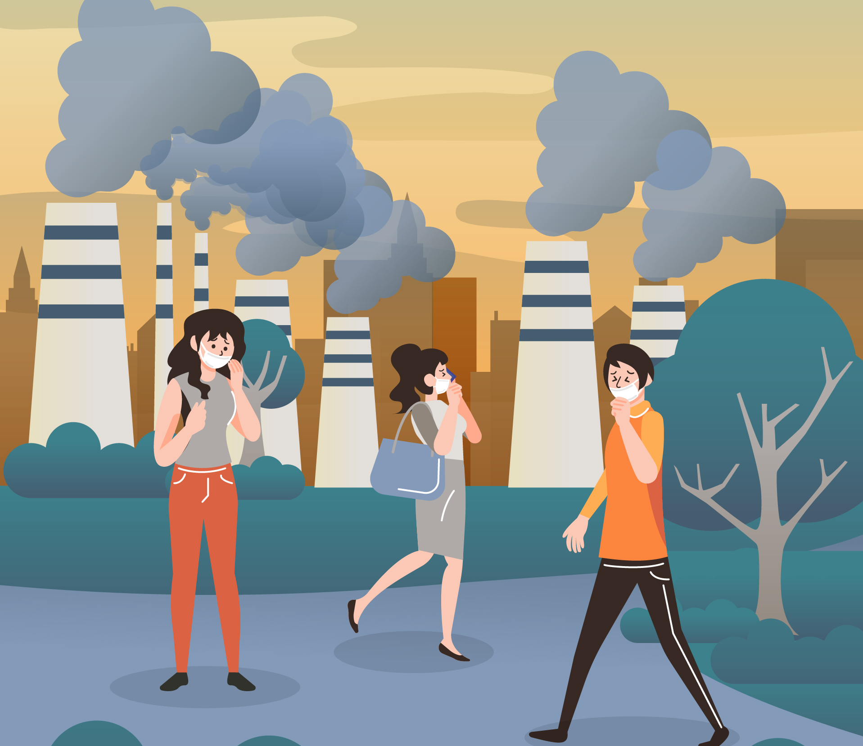
Air Pollution

Slide 3
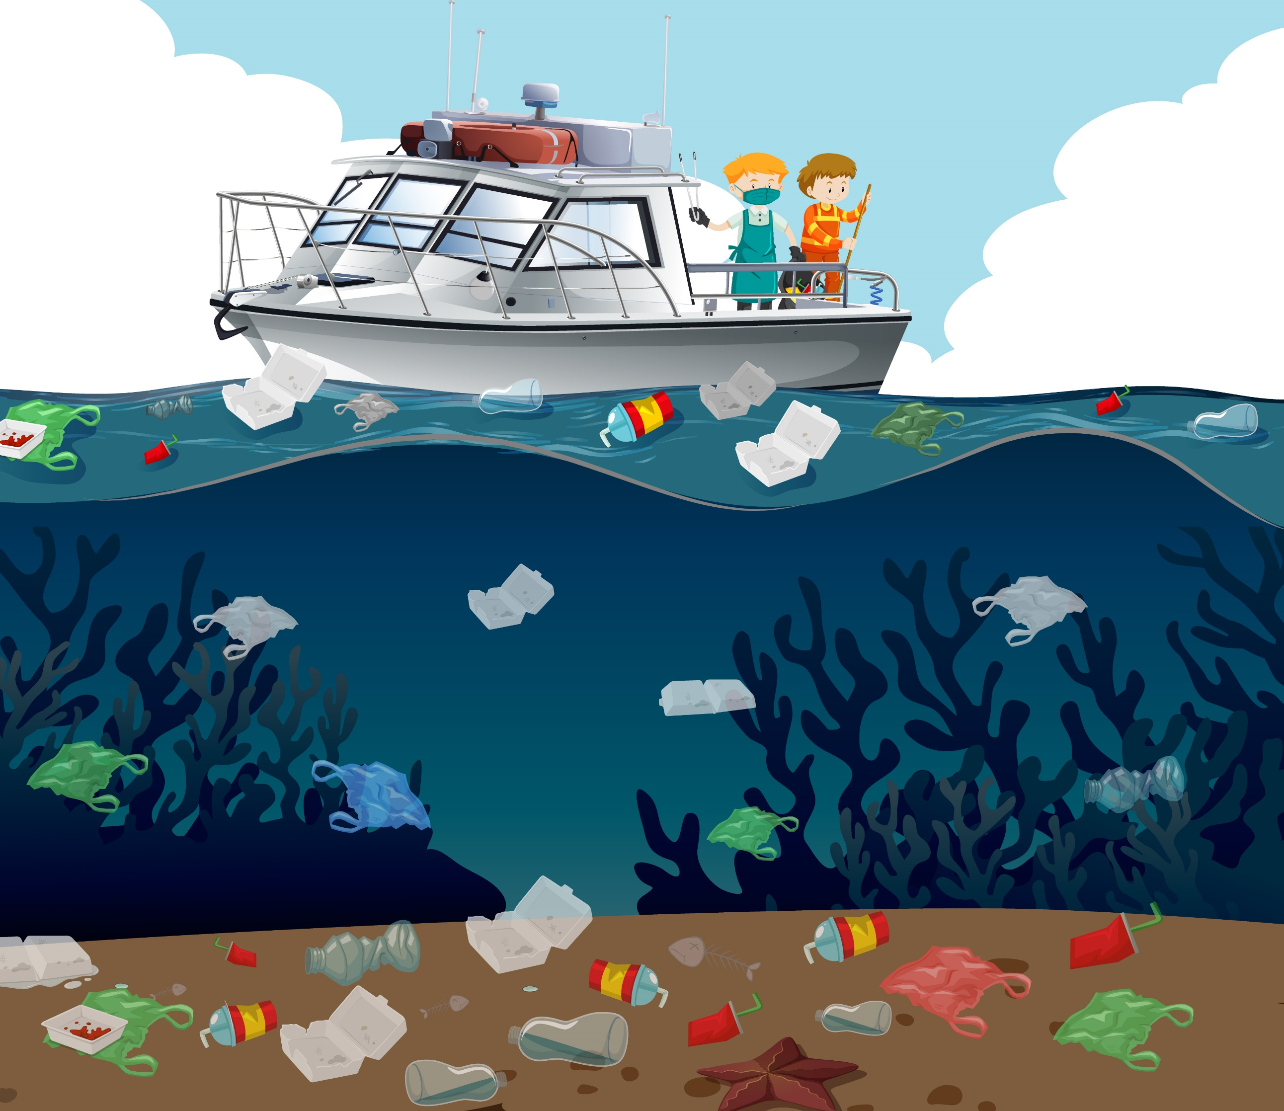
Water Pollution

Slide 4
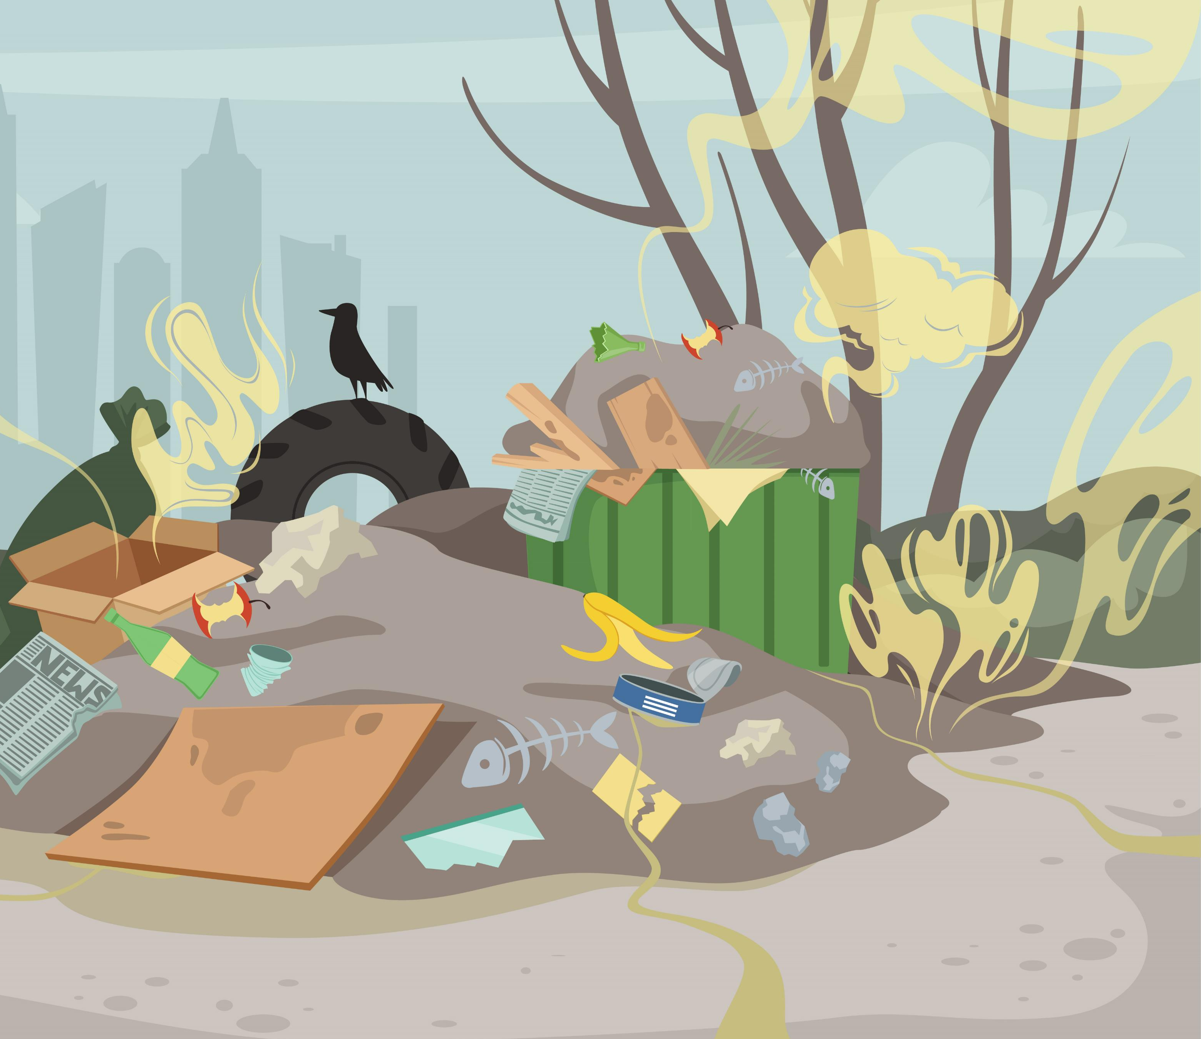
Land Pollution

Slide 5
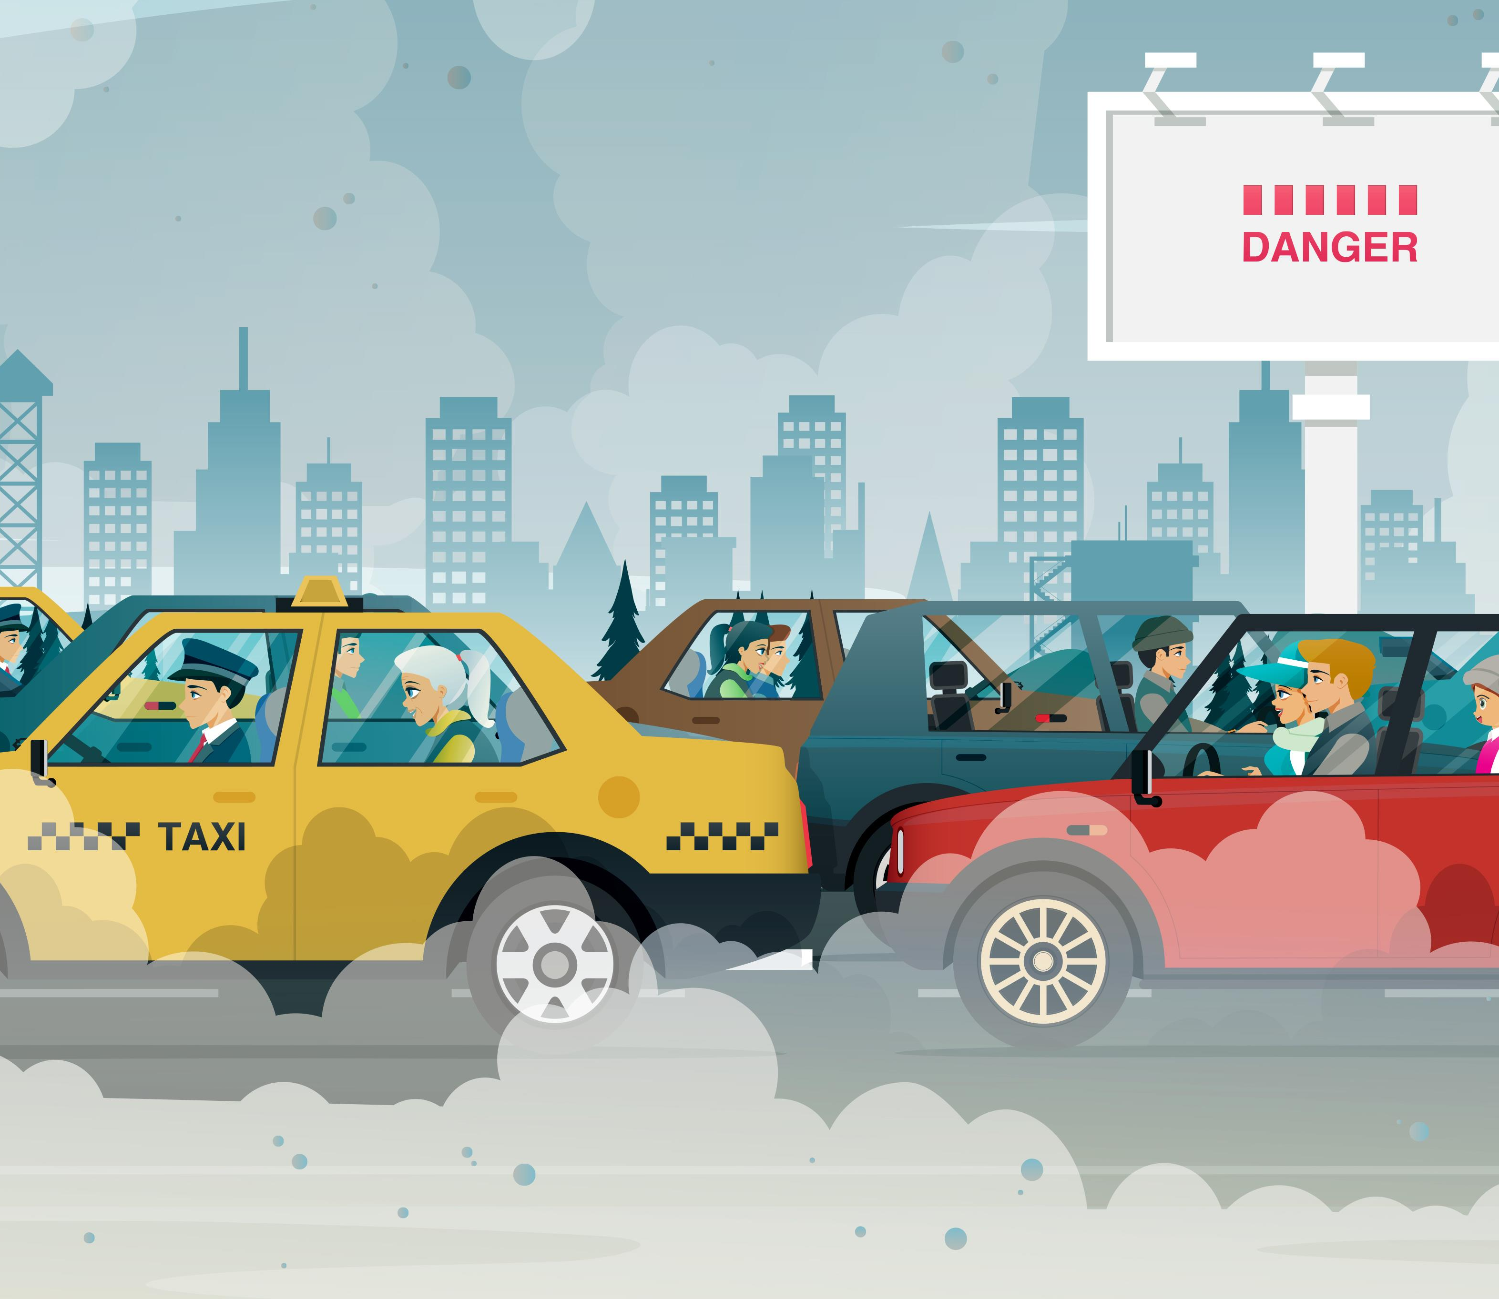
Traffic Pollution

Slide 6

Save the Environment

Slide 7
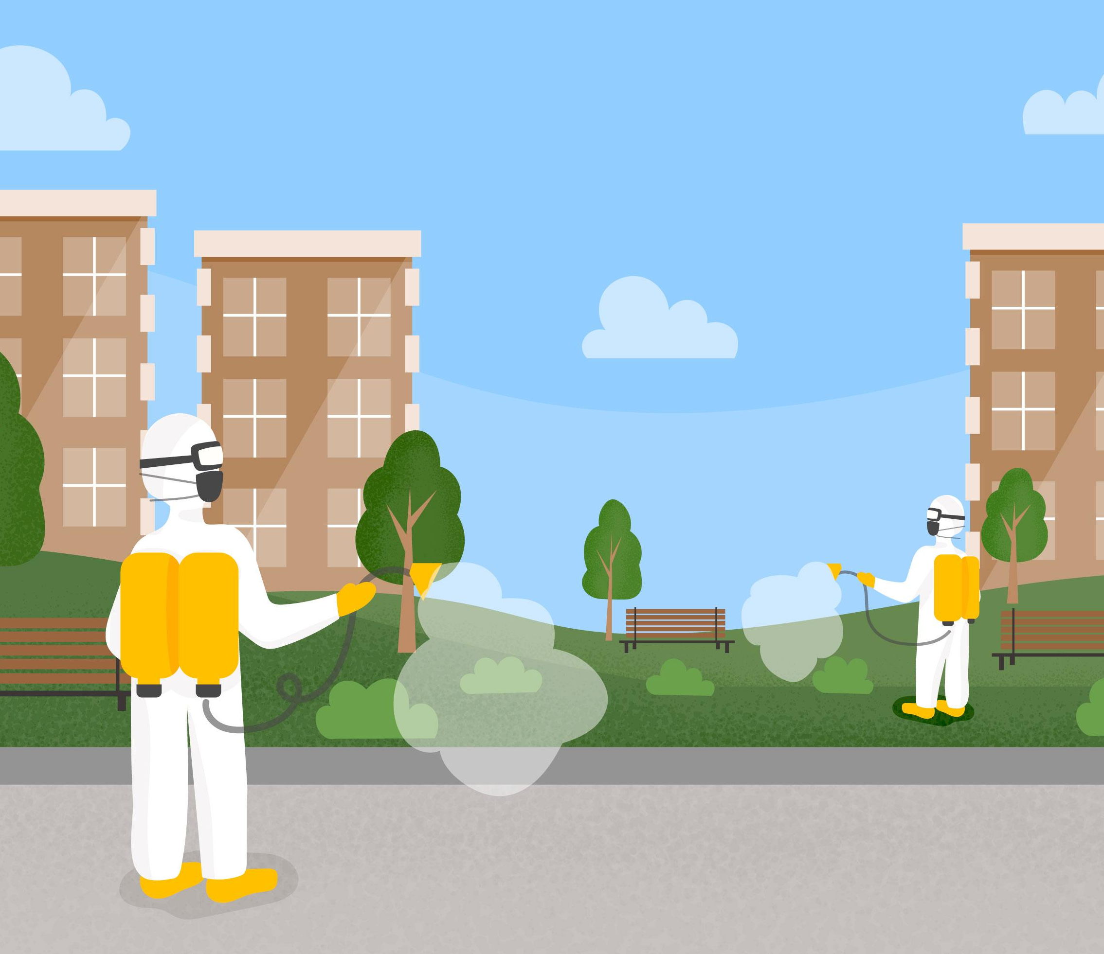
Clean Surroundings

Slide 8
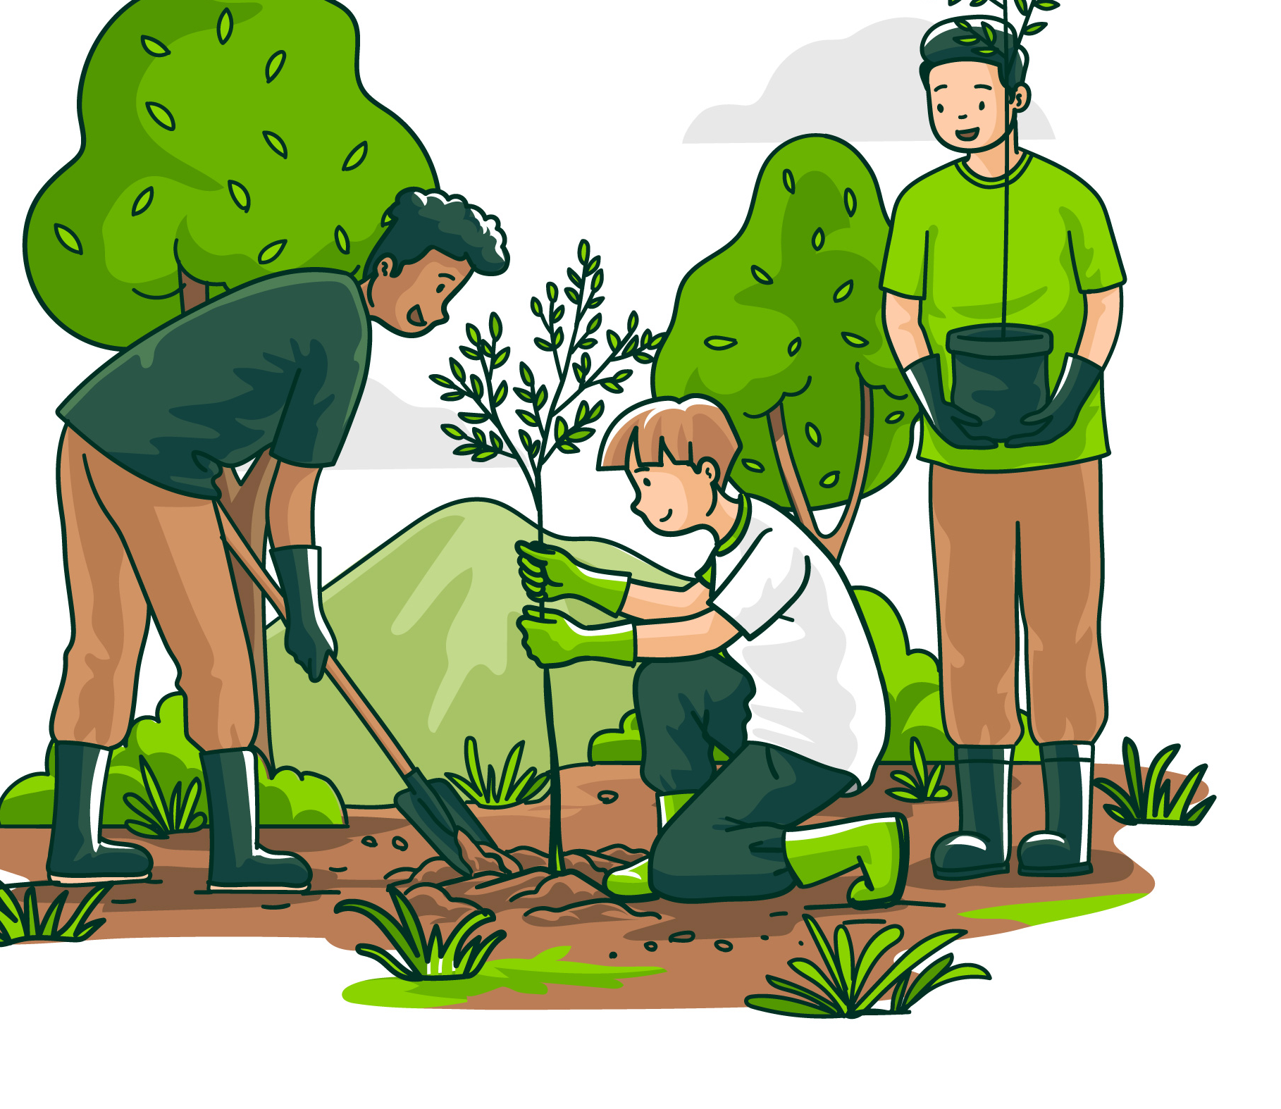
Plant Trees

Slide 9
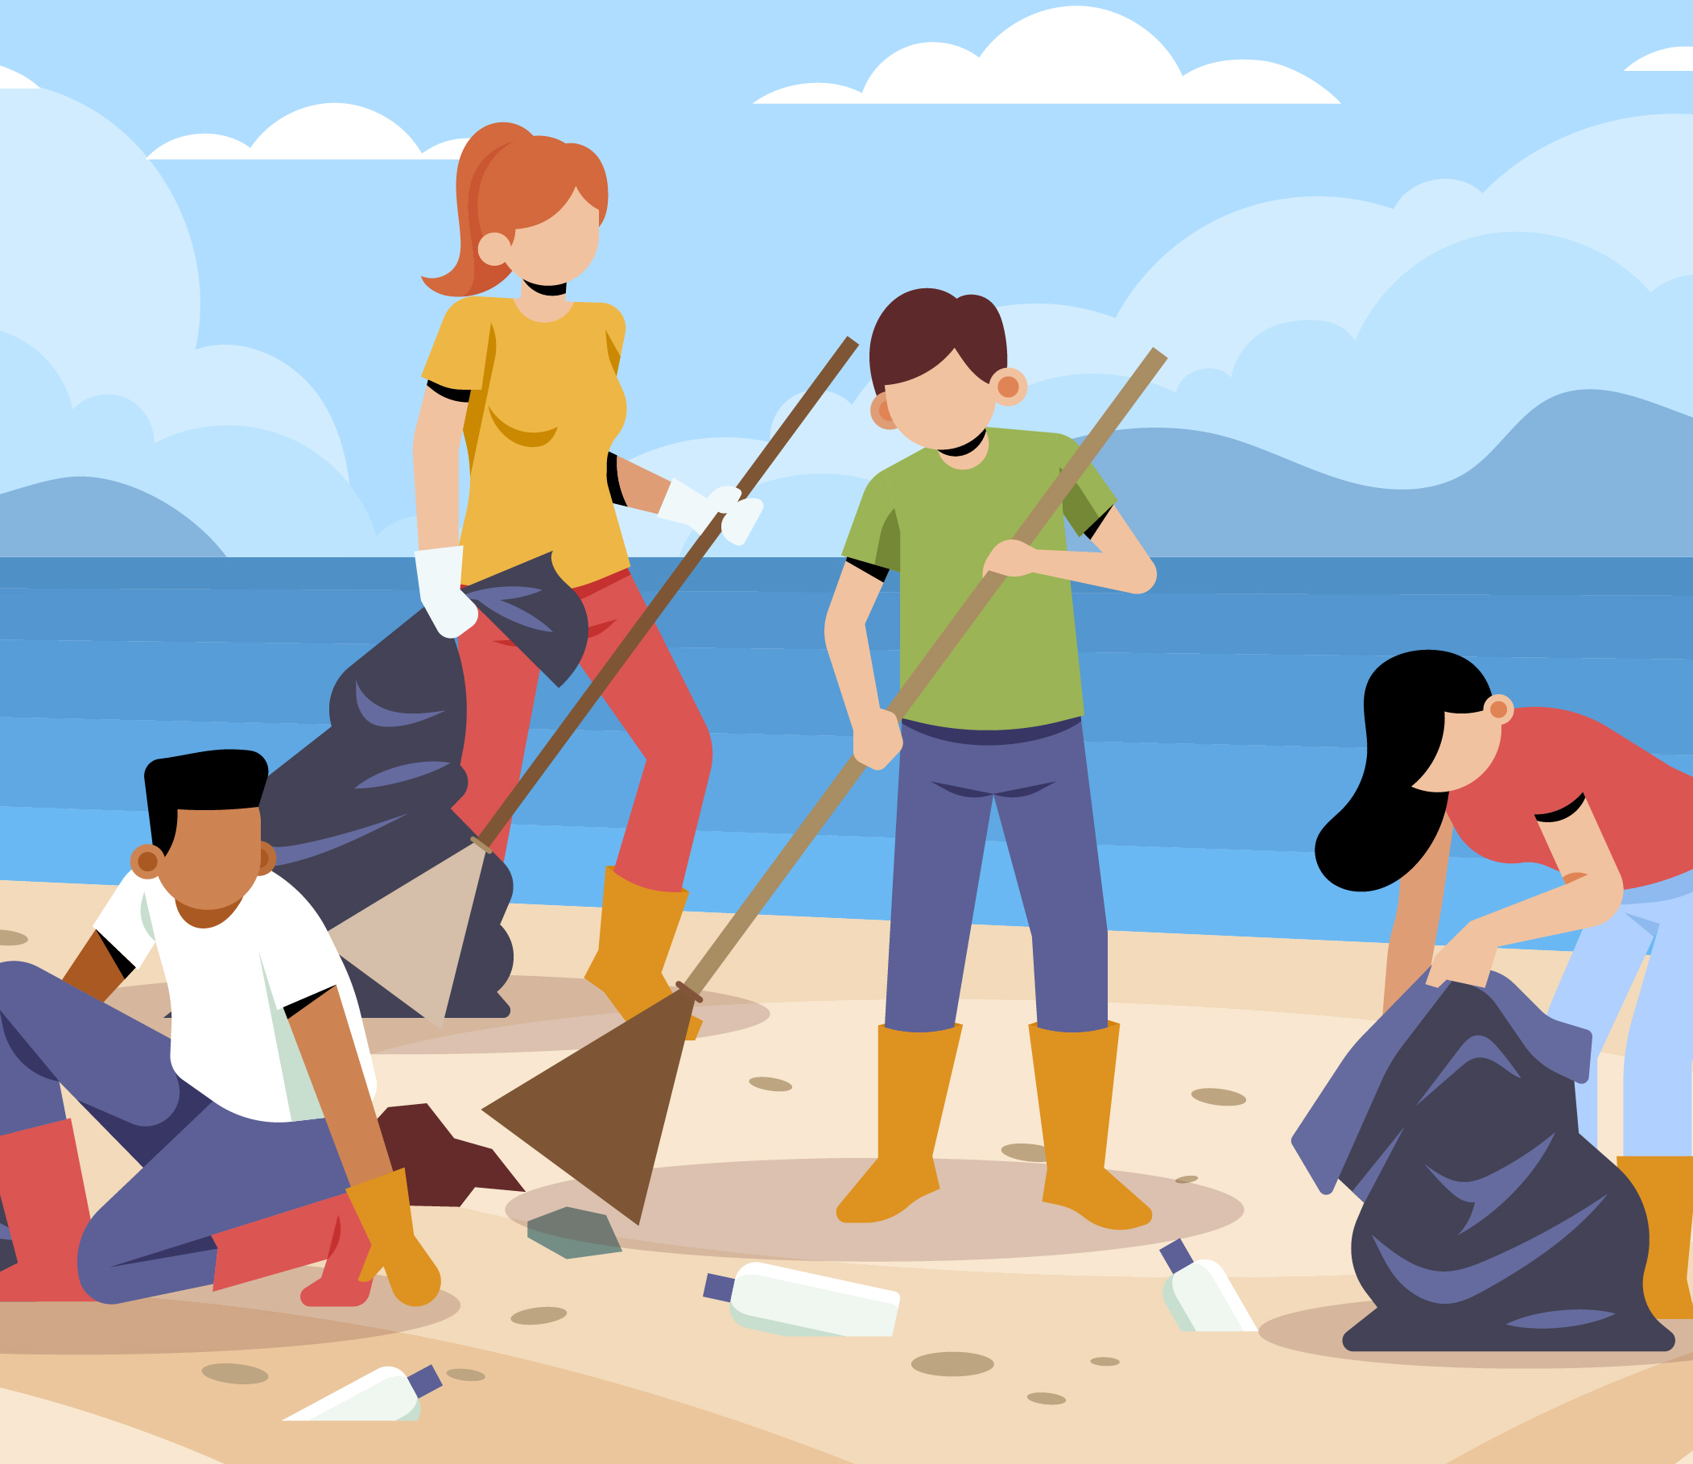
Pick Up Garbage

Slide 10
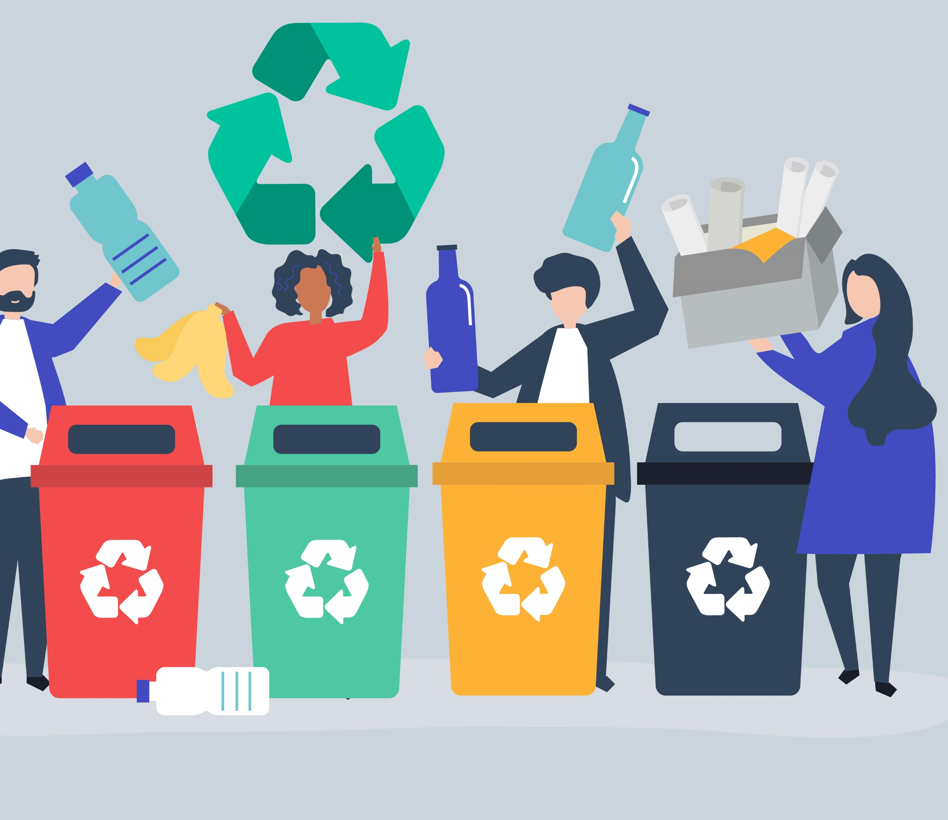
Recycle

Slide 11
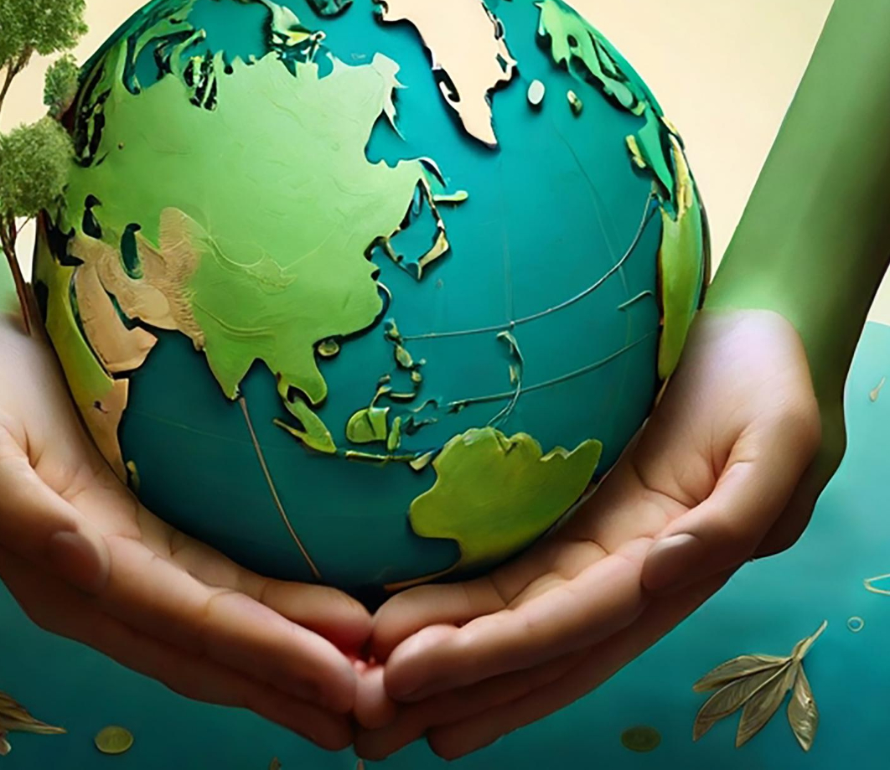
Healthy Planet

Slide 12





2022-1-BG01-KA220-SCH-000085065
School subject: Natural Science
Students’Age: 8 years
Topic: Keeping Environment Clean
Credits: Antalya Directorate Of Education
All media are within the EU intellectual property law.
The European Commission’s support for this publication does not constitute an endorsement of the contents, which reflect the views only of the authors, and the Commission cannot be held responsible for any use which may be made of the information contained herein.

